Slide 1

React Motion

Slide 2
Introduction
React Motion is an animation library for React applications that makes it easy to create and implement realistic animations.
We can directly tie animations to react app state, so through the state change we can control the animation.
To install React Motion, run the following command inside your project root.
npm install --save react-motion | npm i react-motion
React Motion
Page 1

Slide 3
Understanding the exports
The react-motion library exports the following.
spring — A helper function that dictates how the component animates
presets — An object of predefined animation properties
Motion — A component that is used to animate a component
StaggeredMotion — A component that is used to animate components whose animation depends on each other
TransitionMotion — A component that is used to animate the mount and unmounts of components
React Motion
Page 2

Slide 4
Helpers: spring() and presets
The spring() helper function defines how to animate from the initial style value to the destination value. It takes in two arguments: the value and an option animation config parameter.
For example,
spring(10, { stiffness: 130, damping: 42 })
animates the value to 10 with a stiffness of 130 and damping of 42.
React Motion
Page 3

Slide 5
The presets properties are used as the animation configuration. For example,
spring(25, presets.wobbly).
Other preset values include presets.gentle, presets.noWobble, presets.stiff.
React Motion
Page 4

Slide 6
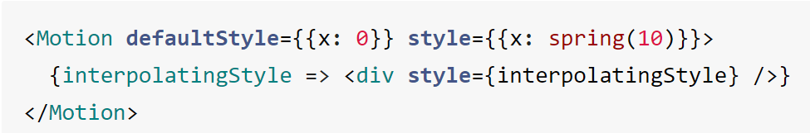
The <Motion /> component
The <Motion /> component takes in two props:
defaultStyle and style.
The defaultStyle prop defines the initial values of the style object. The style prop is an object that defines the style values at any given point. The values of the style prop are determined using the spring() helper function.
Usage :
React Motion
Page 5

Slide 7
<StaggeredMotion />
<StaggeredMotion /> is a component in React Motion, a library for creating animations in React.
The <StaggeredMotion /> component allows you to create animations that happen in sequence, with each element starting its animation after the previous one has finished. This can create a "staggered" effect, where elements appear to move or change in a wave-like pattern.
React Motion
Page 6

Slide 8
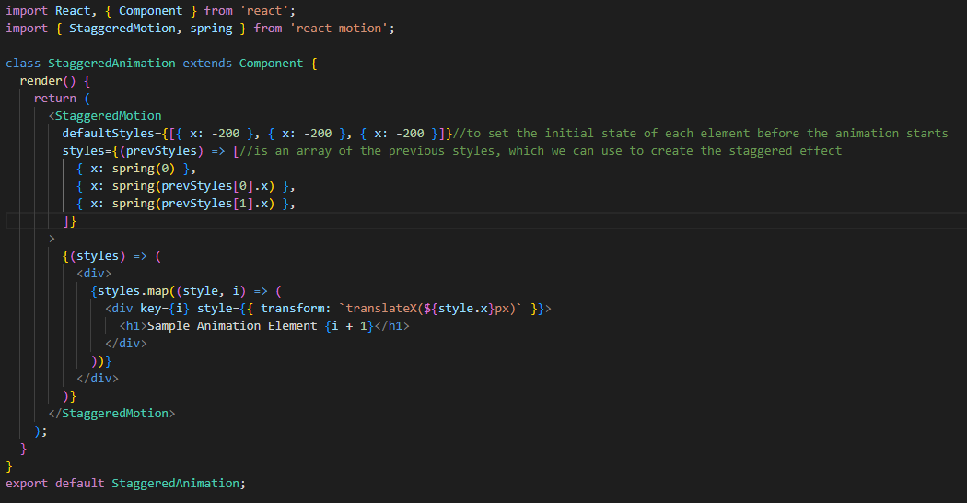
React Motion
Page 7

Slide 9
<TransitionMotion />
TransitionMotion is a React component that enables smooth transitions between different states of a component. It is part of the React Motion library, which provides a simple API for creating animations in React applications.
The TransitionMotion component takes an array of values and maps them to a set of animated components. Each item in the array represents a state of the component, and the component transitions smoothly from one state to another based on changes in the array.
React Motion
Page 8

Slide 10
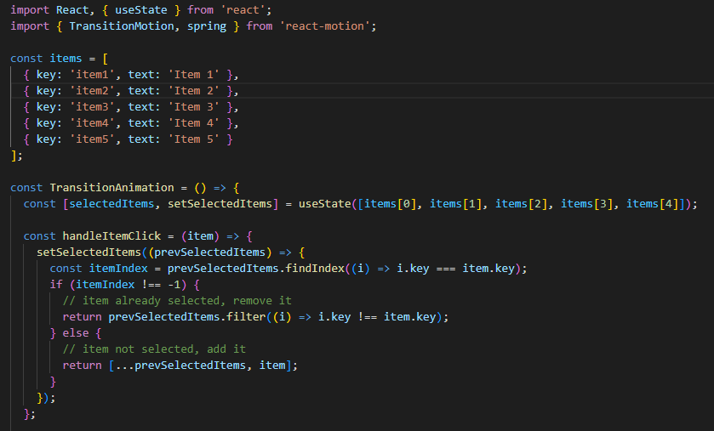
React Motion
Page 9

